Slide 1
Graph Coloring/Exam Scheduling
Ajay Krishna Anand
Gorkem Yar
Saurabh Singh
Sally Shin
Nikolay Popov

Slide 2
Introduction
Brief overview of graph coloring and its applications
2) The program is a C++ implementation of graph coloring algorithms using the Graph class.
3) Introduce the program and its functionalities w/ a demo

Slide 3
Graph Colouring
Graph coloring is a fundamental problem in computer science and mathematics - assigning colors to the vertices of a graph so no two adjacent vertices have the same color
It is used to solve various real-world problems that involve assigning resources to tasks.
Brief overview of graph coloring algorithms
Dsatur coloring
RLF coloring
Welsh Powell coloring
Greedy coloring
SDL coloring
Notes:
Graph coloring is the problem of assigning colors to the vertices of a graph so that adjacent vertices have different colors.
Applications include scheduling problems, map coloring, register allocation, and many more.
Monte Carlo

Slide 4
Dsatur Algorithm
Created by Daniel Brelaz in 1979.
Degree of a vertex: number of edges connected to that vertex.
Degree of saturation: number of colored vertices that is connected to vertex.
A heuristic algorithm with a greedy property of picking vertex with maximum degree of saturation.
Complexity O(V^2) where V is the number of vertices.
Provides correct solutions for bipartite, wheel

Slide 5
Dsatur Algorithm Pseudocode
Pseudocode (Brelaz,1979):
1.Pick the vertex with maximal degree and color it with 1.
2. Choose a vertex with a maximal saturation degree. If there is an equality, choose any vertex of maximal degree in the uncolored subgraph.
3. Color the chosen vertex with the least possible (lowest numbered) color.
4. If all the vertices are colored, stop. Otherwise, return to 3.

Slide 6
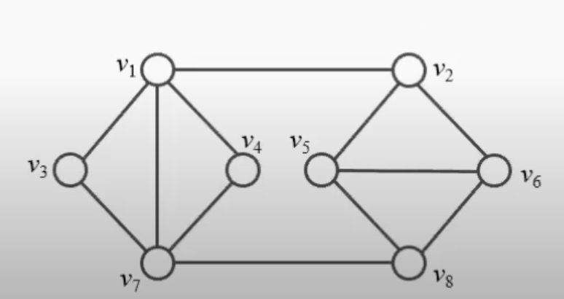
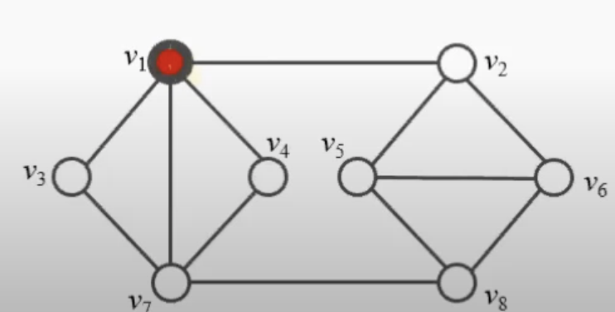
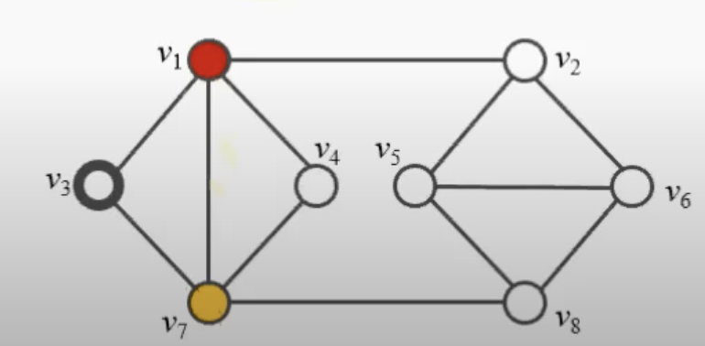
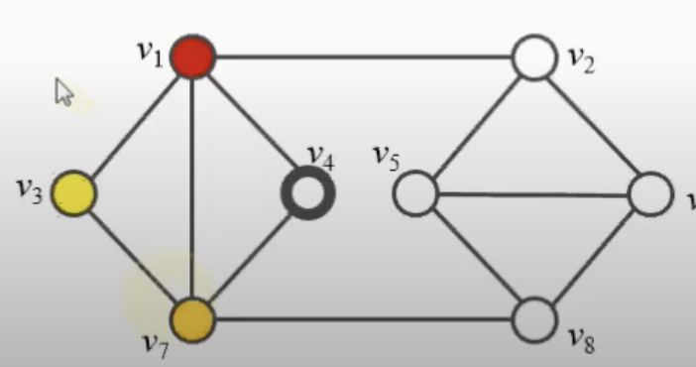
Dsatur Example

Slide 7
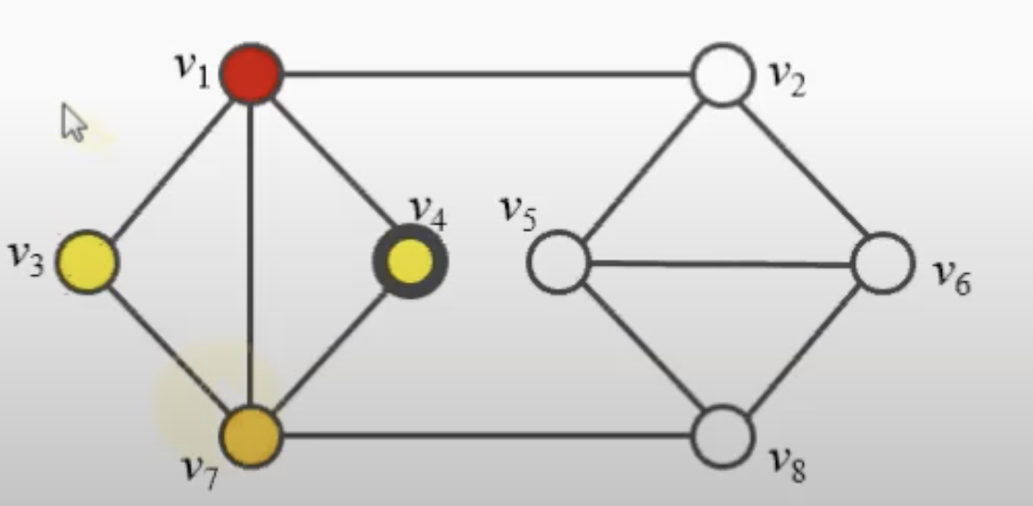
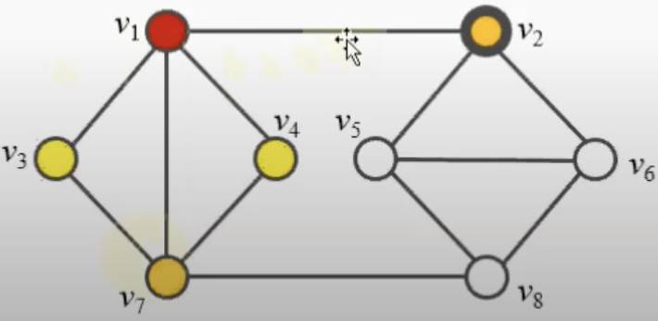
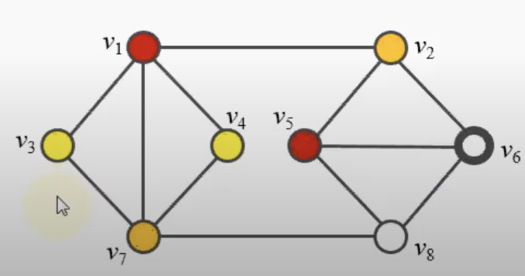
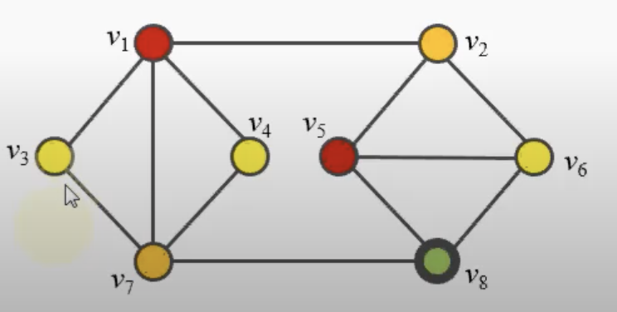
Dsatur Example

Slide 8
RLF (Recursive Largest First) Algorithm
Proposed by Frank Leighton in 1979.
A heuristic algorithm with a greedy property of picking vertex with maximum degree than assigning the least color.
Least color means the color which has assigned to minimum number of vertices.
Time complexity is O(V^3) where V is the number of vertices. Can be O(V^2) in sparse graphs.

Slide 9
RLF Algorithm Pseudocode
Note: Let S = an empty solution. Also, let G = (V, E) be the graph we wish to color, comprising a vertex set V and an edge set E.
1. The first vertex added to S should be the vertex in G that has the largest number of neighbors
2. Subsequent vertices added to S should be chosen as those that
Find the vertices that are not currently adjacent to any vertex in S
Sort the vertices according to their maximal number of neighbors that are adjacent to vertices in S
(In a ties condition select the vertex with the minimum number of neighbors not in S.)
3. Remove S from G, check whether G is empty if not start from the beginning

Slide 10
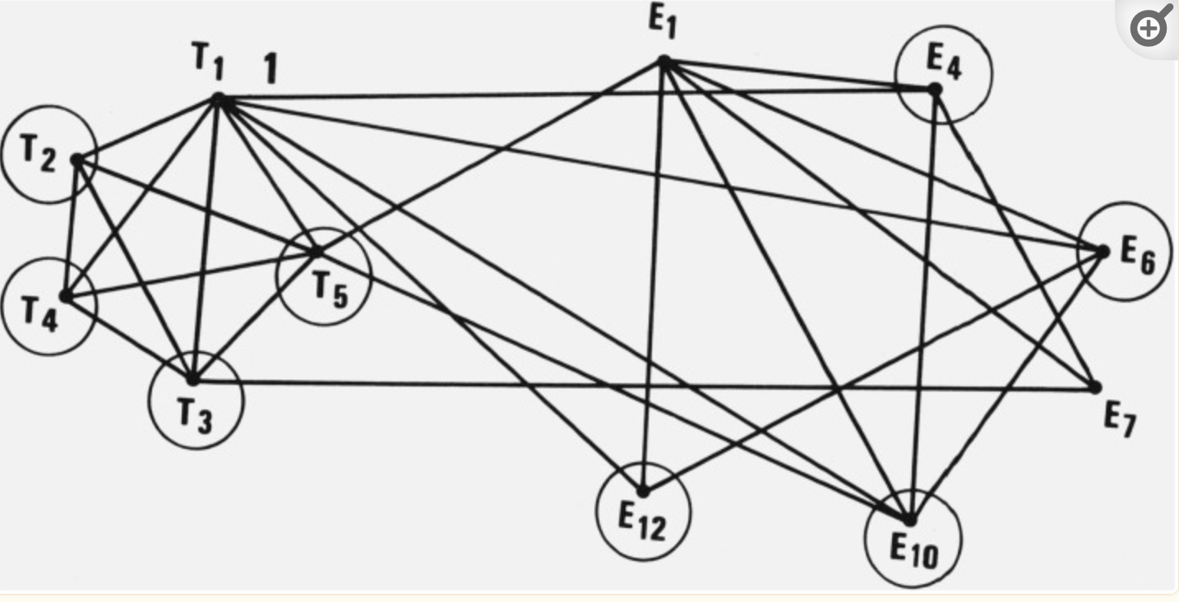
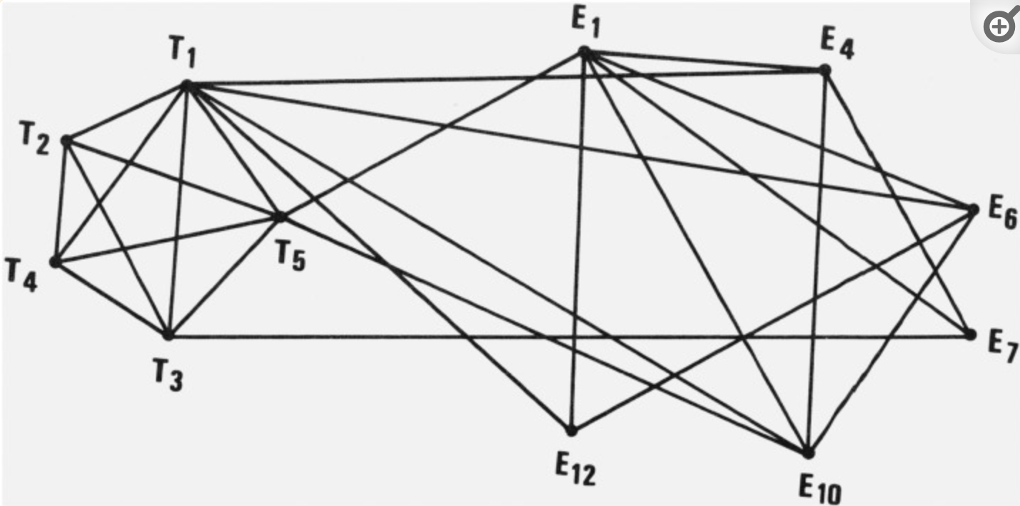
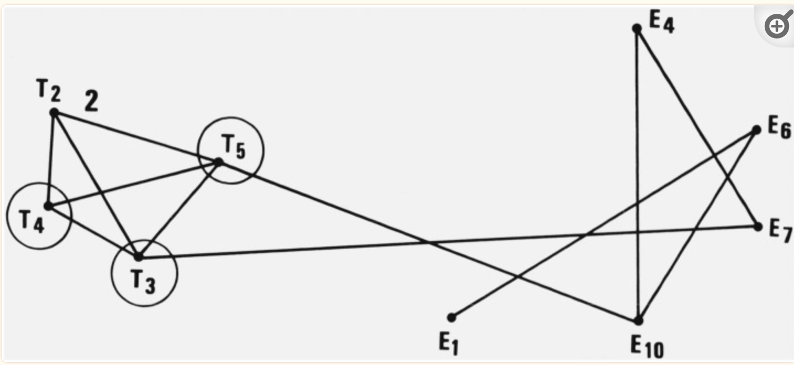
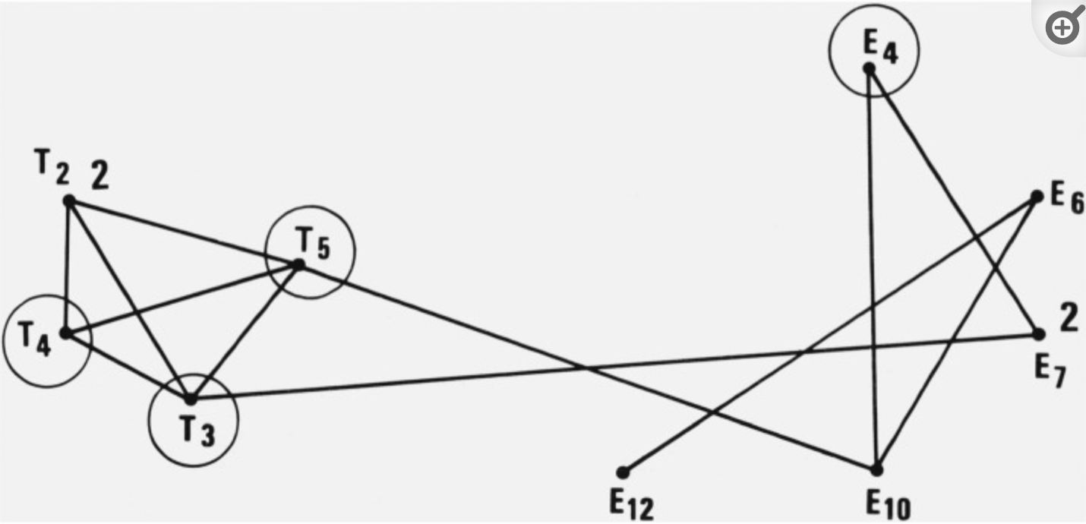
RLF Example:

Slide 11
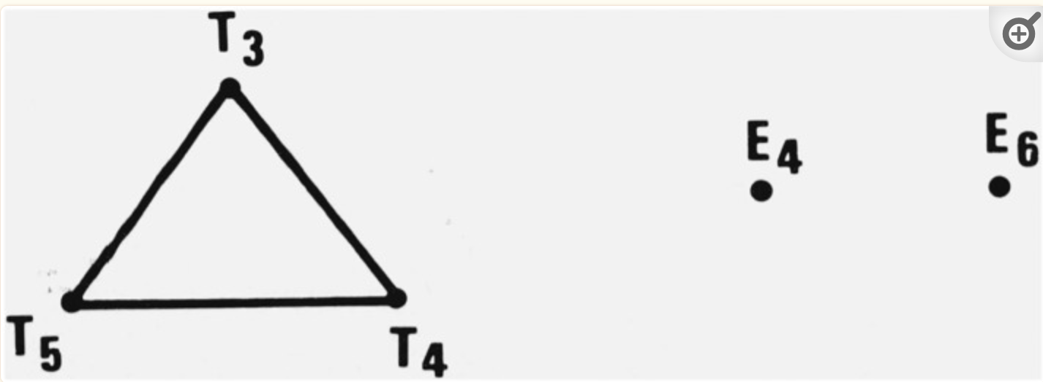
RLF Example

Slide 12
Welsh Powell Algorithm
First introduced in 1967 by Welsh & Powell in their paper “An upper bound for the chromatic number of a graph and its application to timetabling problems”
Welsh-Powell is a graph coloring algorithm that colors a graph with as few colors as possible.
It's a greedy algorithm that colors the vertices in descending order of degree.

Slide 13
Advantages
The Welsh Powell algorithm is simple and easy to implement.
It runs in O(|V|^2) time, which is efficient for many types of graphs.
It produces good colorings for many types of graphs

Slide 14
Time Complexity
In the worst case, the Welsh-Powell algorithm will color a graph with Δ + 1 colors, where Δ is the maximum degree of any vertex in the graph.
This is because the algorithm colors the vertices in descending order of degree, so the last vertex to be colored has degree at most Δ.
Thus, the time complexity of Welsh-Powell is O(|V| + |E|), where |V| is the number of vertices in the graph and |E| is the number of edges.
This is because we need to sort the vertices, which takes O(|V| log |V|) time, and then we need to color each vertex, which takes O(Δ) time.

Slide 15
Algorithm
Welsh Powell Algorithm consists of following Steps :
Find the degree of each vertex
List the vertices in order of descending degrees.
Colour the first vertex with color 1.
Move down the list and color all the vertices not connected to the coloured vertex, with the same color.
Repeat step 4 on all uncolored vertices with a new color, in descending order of degrees until all the vertices are coloured

Slide 16
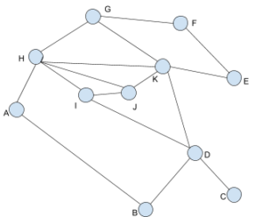
H | K | D | G | I | J | A | B | E | F | C
5 | 5 | 4 | 3 | 3 | 3 | 2 | 2 | 2 | 2 | 1

Slide 17
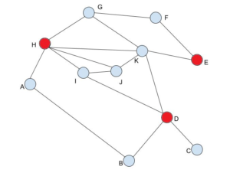
H | K | D | G | I | J | A | B | E | F | C
5 | 5 | 4 | 3 | 3 | 3 | 2 | 2 | 2 | 2 | 1

Slide 18
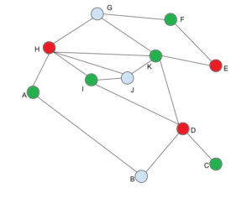
H | K | D | G | I | J | A | B | E | F | C
5 | 5 | 4 | 3 | 3 | 3 | 2 | 2 | 2 | 2 | 1

Slide 19
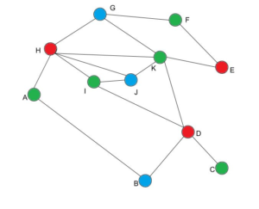
H | K | D | G | I | J | A | B | E | F | C
5 | 5 | 4 | 3 | 3 | 3 | 2 | 2 | 2 | 2 | 1

Slide 20
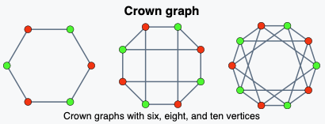
Greedy Algorithm
On graph coloring, algorithm procedurally assigns colors to each vertex after some ordering of the vertices
Efficient and can be implemented in linear time: O(V + E)
Not guaranteed to be most optimal result, and may differ every time
Can be especially challenged with crown graphs, a complete bipartite graph with even number of nodes
Finding optimal ordering of vertices is NP-hard problem
Finding the number of colors made by worst ordering is a NP-complete

Slide 21
Greedy Algorithm: Pseudocode
Sort nodes based on their degree of connection in increasing order
Can be ordered in other ways as well
Initialize all nodes to white (starting color)
Color first node with first color
Color remaining nodes by checking the colors of connected nodes and assigning first color in the set not found
If no color in the set is found, color the node with a new color, add the color to set

Slide 22
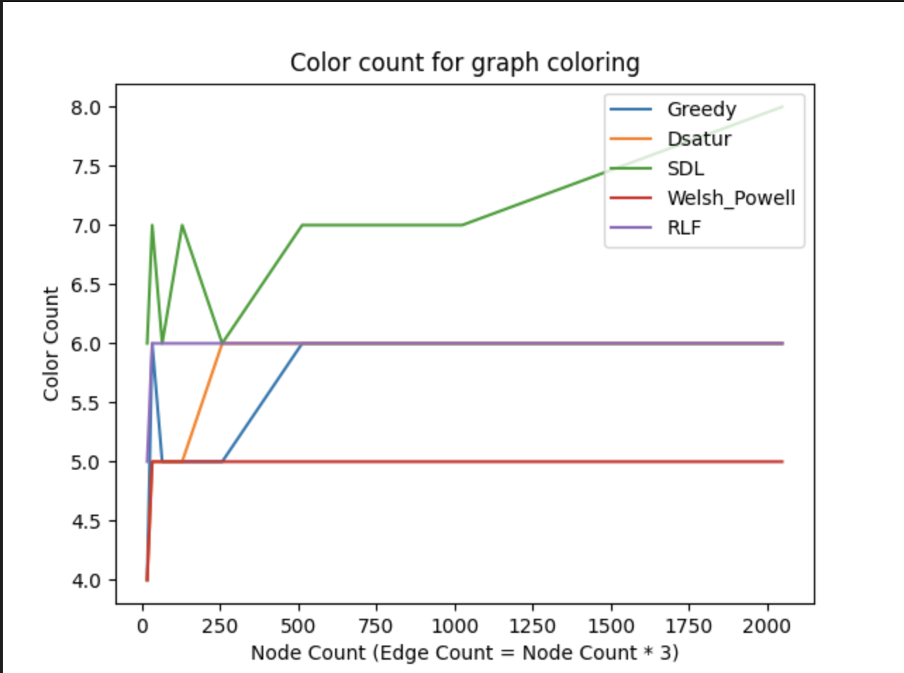
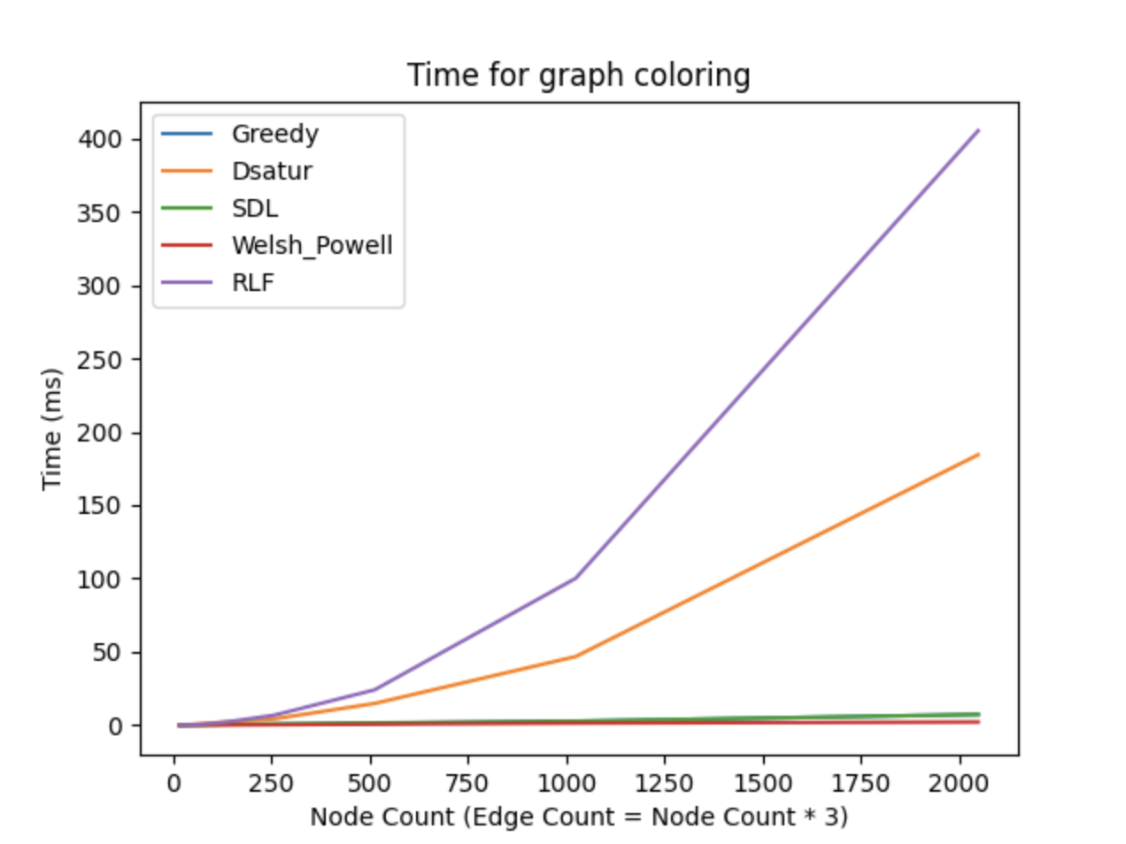
Analysis Sparse Graph

Slide 23
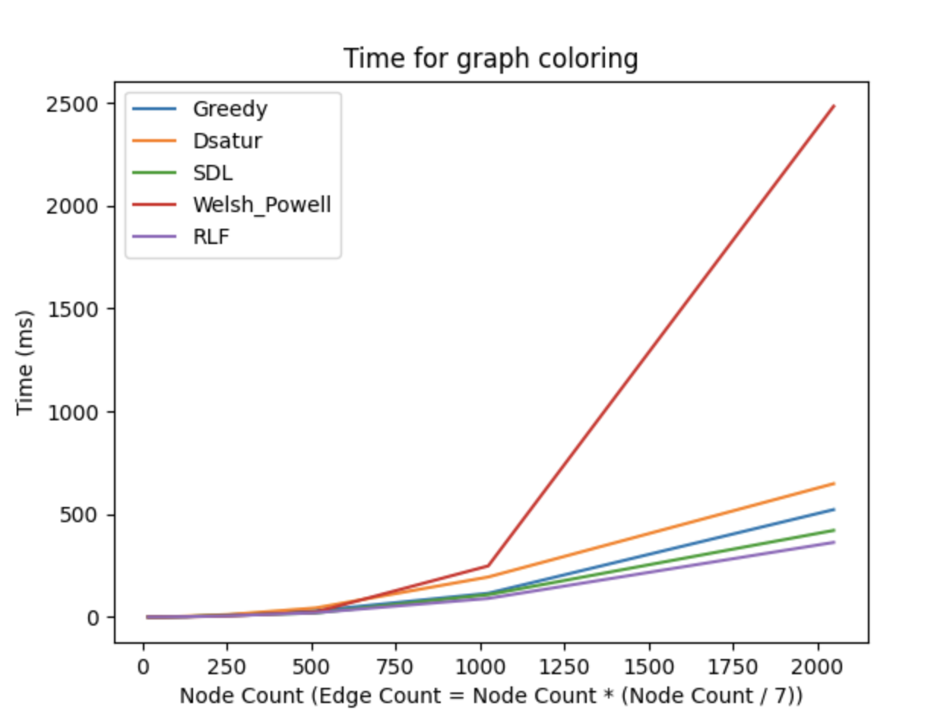
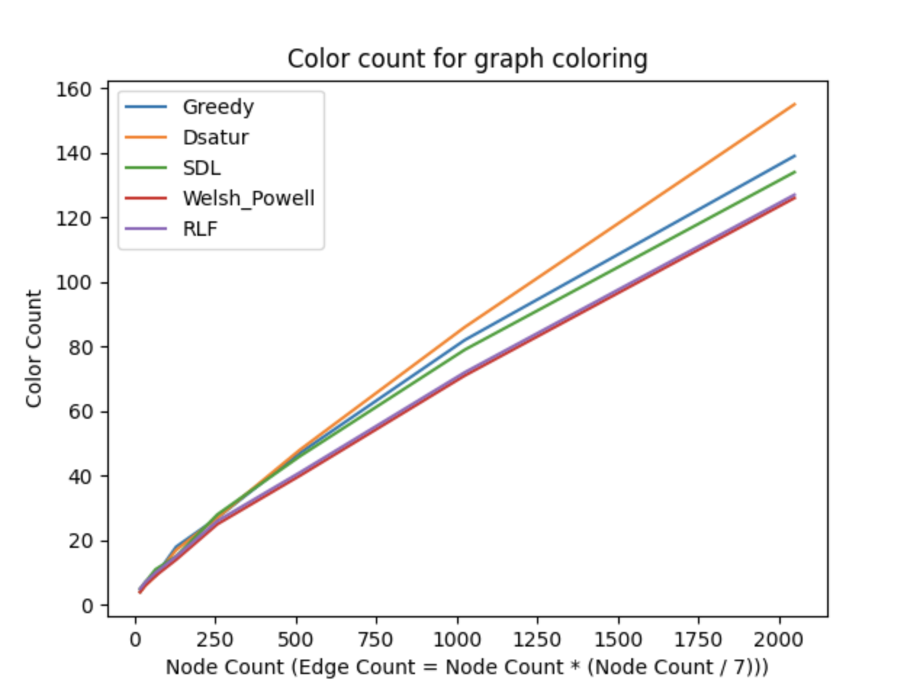
Analysis Dense Graph
In order to analyze large dense graphs, we decided to use edge count as n*(n/7).

Slide 24
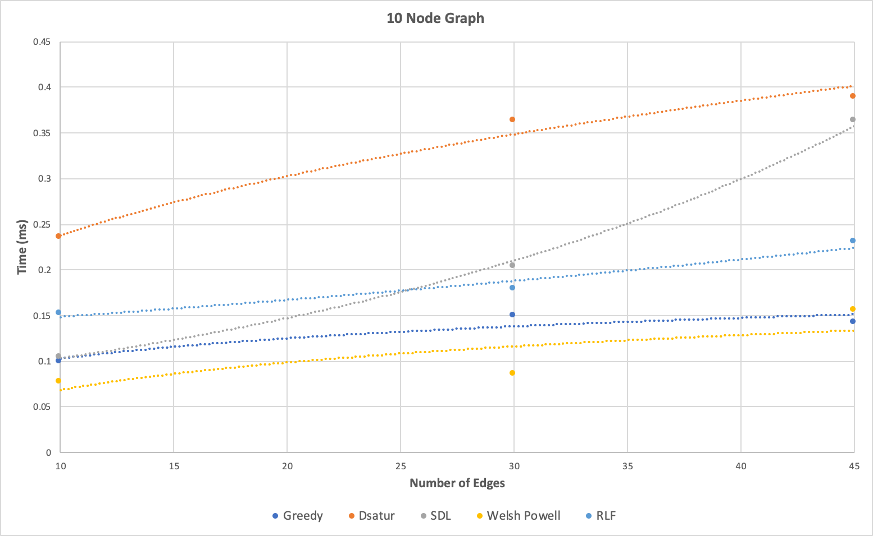
Runtime Complexity Analysis - 10 Node Graph
Notes:
Max edges: 45

Slide 25
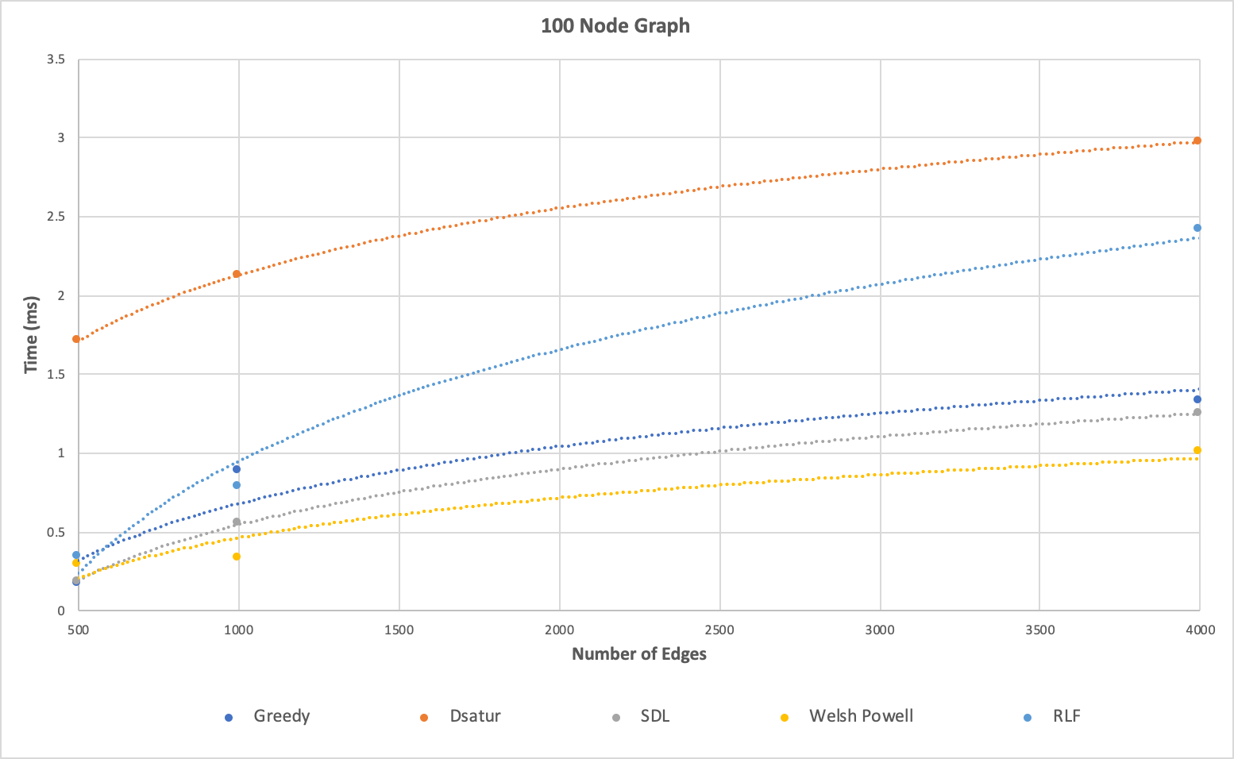
Runtime Complexity Analysis - 100 Node Graph
Notes:
Max edges 4500

Slide 26
C++ Program Overview
The program is designed to generate a random graph and apply a chosen graph coloring algorithm to the vertices.
The main function takes command-line arguments for the number of nodes, the number of edges, and the chosen algorithm.
It creates a random graph using the Courses class and applies the selected algorithm to the vertices.
It prints the results to the console and outputs the graph as JSON.

Slide 27
Graph class
The Graph class is a template class that represents a graph.
It has functions for adding vertices and edges, generating random graphs, and applying graph coloring algorithms.
The random graph is created using the generate_random_graph function, which takes a lambda function as an argument that generates random courses.
The graph is generated by adding vertices with the generated courses and then randomly connecting them with edges.
The Graph class has functions for applying graph coloring algorithms:
Dsatur_coloring
Greedy_coloring
SDL_coloring
welsh_powell_coloring

Slide 28
References
1 - Brélaz, Daniel (1979-04-01). "New methods to color the vertices of a graph". Communications of the ACM. 22 (4): 251–256.
2 - Samsul Arifin et al 2022 J. Phys.: Conf. Ser. 2279 012005
3 - Leighton FT. A Graph Coloring Algorithm for Large Scheduling Problems. J Res Natl Bur Stand (1977). 1979 Nov-Dec;84(6):489-506. doi: 10.6028/jres.084.024. PMID: 34880531; PMCID: PMC6756213.

